Slide 1

FREEDOM OF INFORMATION ACT
ALSO KNOWN AS FOIA
29 Del. C. §§ 10001-10008

Slide 2
Introduction
Presented by:
Deputy Attorney General
Lauren Maguire

Slide 3
DISCLAIMERS
The legislature specifically provided that this presentation is NOT to be construed as legal advice
The information that follows summarizes the law
We cannot cover every situation
We cannot address fact-specific questions
If you have a question . . .
Contact your legal counsel
Review the Department of Justice’s Policy Manual for FOIA Coordinators, which is available at: https://attorneygeneral.delaware.gov/executive/open-government/

Slide 4
Legislative Declaration
“It is vital in a democratic society that public business be performed in an open and public manner so that our citizens shall have the opportunity to observe the performance of public officials and to monitor the decisions that are made by such officials in formulating and executing public policy; and further, it is vital that citizens have easy access to public records in order that the society remain free and democratic. Toward these ends, and to further the accountability of government to the citizens of this State, this chapter is adopted, and shall be construed.”
29 Del. C. § 10001

Slide 5
Purposes of FOIA
Promote governmental transparency and accountability
Inform citizens
Make it possible for citizens to observe and monitor the performance of public officials

Slide 6
FOIA Manual
Created by the Department of Justice to assist FOIA Coordinators
Located on the Department of Justice Open Government webpage
Intended as an “easy reference” for FOIA
Updated biennially; last update was October 2023

Slide 7
FOIA Training
Will be presented annually
Open to the public
Provides guidance for FOIA Coordinators and others involved in responding to FOIA requests to a public body
Will discuss the FOIA statute, cases, and Attorney General opinions that interpret the statute

Slide 8
What This Presentation Will Cover
FOIA Coordinators’ Duties and Responsibilities presented by Deputy Attorney General Dorey Cole
FOIA Petitions presented by Deputy Attorney General Dorey Cole
Responding to Requests for Public Records presented by Deputy Attorney General John Tarburton
Fees presented by Deputy Attorney General Joseph Handlon
Open Meetings presented by Deputy Attorneys General Jason Staib & Emily Burton
Public Comment presented by Deputy Attorney General Victoria Groff
Executive Sessions presented by Deputy Attorney General Victoria Groff
Virtual Meetings presented by Deputy Attorney General Victoria Groff
Panel of FOIA Coordinators – Questions & Answers Session presented by Deputy Attorneys General Victoria Groff and Emily Burton
Judicial and AG Opinions re: FOIA for the last two years

Slide 9
FOIA Coordinators’ Duties and Responsibilities
Presented by:
Deputy Attorney General
Dorey Cole

Slide 10
FOIA Coordinators
All public bodies must designate a FOIA Coordinator and:
Provide the Department of Justice the FOIA Coordinator’s name and contact information
OpenGovernment@delaware.gov
Identify the FOIA Coordinator on the public body’s website
State of Delaware FOIA Coordinators: https://delaware.gov/foia-coordinators/
Inform the Department of Justice and update the website within 20 working days of any change
29 Del. C. § 10003(g)(1)

Slide 11


Slide 12
FOIA Coordinators
Responsible for coordinating and processing FOIA requests
Required to:
Coordinate public body’s responses to FOIA requests
Assist requesting party in identifying records sought
Assist public body in locating & providing records
Work to foster cooperation with requesting party
Maintain a document that tracks all FOIA requests

Slide 13
FOIA tracking sheet must include:
Requesting party’s contact information
Date public body received FOIA request
Public body’s response deadline
Date of public body’s response (including the reasons for an extension)
Names, contact information & dates of correspondence of those contacted in connection with a FOIA request
Dates of review of documents responsive to request
Names of individuals who conducted review
Whether documents were produced
Amount of administrative & copying fees assessed
Date of final disposition of FOIA request

Slide 14
Statute Provides Policies Governing:
Form of FOIA requests (in person, by U.S. mail, fax, or online)
Roles and duties of FOIA Coordinator
How a public body should respond to:
a FOIA request generally
a FOIA request for emails
a FOIA request for non-custodial records

Slide 15
Statute Provides Policies Governing:
How a public body should review records to identify exemptions from the definition of “public record”
Access that must be provided for review of public records
Fees applicable to searching, copying & producing records

Slide 16
FOIA Petitions
Presented by:
Deputy Attorney General
Dorey Cole

Slide 17
What is a Petition?
Complaint filed with the Attorney General’s Office alleging FOIA was violated or about to be violated. 29 Del. C. § 10005(e).
Filed against any Delaware public body

Slide 18
Petitions to the Attorney General
Rules of Procedure:
https://attorneygeneral.delaware.gov/wp-content/uploads/sites/50/2023/05/DDOJ-Rules-of-Procedure-for-FOIA-Petitions-and-Determinations-FINAL.pdf

Slide 19
Steps in the Petition Process
Citizen files a petition with the DOJ FOIA Office
FOIA Office reviews the petition
In most situations, FOIA Office sends a letter to the public body notifying of the petition and providing six business days to respond
Public body sends its response to the FOIA Office, with a copy to the petitioner
Determination issued to the parties

Slide 20
Petitions to the Attorney General
Time Limitations on Filing a Petition
Petitions alleging an improper denial of records by a State agency, department, or board: 60 days from the denial
All other petitions – non-State entities’ records denials and all public bodies’ open meeting violations: 6 months from date of alleged violation

Slide 21
Petitions to the Attorney General
Attorney General Opinions posted online:
https://attorneygeneral.delaware.gov/opinions/

Slide 22
Will the public body need to provide an affidavit when answering a FOIA Petition?
In most cases, YES

Slide 23
Judicial Watch
Unless it is clear on the face of the request that the demanded records are not subject to FOIA, the public body must determine if it has responsive records.
When a FOIA response is challenged, the burden of proof is on the public body.
Detailed affidavit - a description of the search and the outcome of the search (such as, who provided the information relevant to whether the public body has responsive records, when such inquiries were made, what, if any, documents were reviewed, and why the designated locations were searched).
Unsworn or generalized statements are not sufficient.

Slide 24
Judicial Watch cases
Judicial Watch v. Del. Dep't of Justice, 2021 WL 22550 (Del. Super. Jan. 4, 2021)
Judicial Watch, Inc. v. Univ. of Del., 267 A.2d 996 (Del. 2021): affirmed in part, reversed in part, and remanded in part to the Superior Court
Judicial Watch, Inc. v. Univ. of Del., 2022 WL 2037923 (Del. Super. June 7, 2022)
Judicial Watch, Inc. v. Univ. of Del., 2022 WL 10788530 (Del. Super. Oct. 19, 2022), aff'd, 2023 WL 4377918 (Del. July 6, 2023)
Judicial Watch, Inc. v. Univ. Of Del., 2024 WL 3650205 (Del. Super. Aug. 5, 2024)

Slide 25
Affidavit Drafting Tips
Do not merely repeat the standard
Be specific – err on the side of including more details
Show that the public body conducted a search reasonably calculated to uncover the responsive records
Where records are kept and how those locations were searched

Slide 26
Affidavit Samples
Attorney General Opinion No. 24-IB37
(Affidavit met standard)
Request for complaints about a certain property.
Affidavit from Assistant Land Use Director: “I conducted a records review of [the Land Use] Department’s electronic repository for documents associated with [the property]; this would have captured any written complaints. I located no responsive documents pertaining to that portion of the request. I also reviewed permit files for [the property] and found no responsive documents pertaining to that portion of the request. I further corresponded with the Department's Building Inspections supervisor, who would have received or been made aware of any written complaints of the kind requested; he informed me that Building Inspections did not possess any responsive records.”

Slide 27
Affidavit Samples
Attorney General Opinion No. 25-IB23
(Affidavit did not meet standard)
Request for communications involving representatives of the Civic Committee and others
Affidavit from Chair of Civic Committee: “. . . provided [requesting party] with all documents responsive to [the] February 20, 2025 request”

Slide 28
Responding to Requests For Public Records Presented by: Deputy Attorney General John E. Tarburton
28

Slide 29
FOIA Policy Public bodies must have a FOIA policy
The Delaware FOIA statute requires that all public bodies adopt a policy to address FOIA requests (29 Del. C. § 10003(b)).
The policy can not violate the FOIA statute.
A FOIA request may not be denied solely because the promulgated form is not used (29 Del. C. § 10003(f)).
A FOIA policy may include provisions for the waiver of some or all administrative fees, which must apply equally to a particular class (e.g., non-profit organizations) (29 Del. C. § 10003(m)(2)).
Notes:
Waiver is of admin fees only

Slide 30

Title 8 of Delaware’s Administrative Code
Title 8 of Delaware’s Administrative Code lists the FOIA Policies and Procedures for various State agencies.

Slide 31
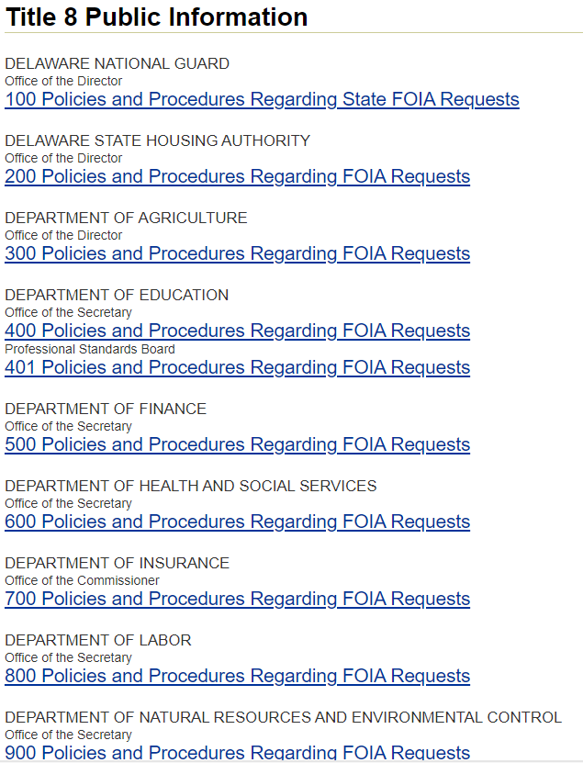
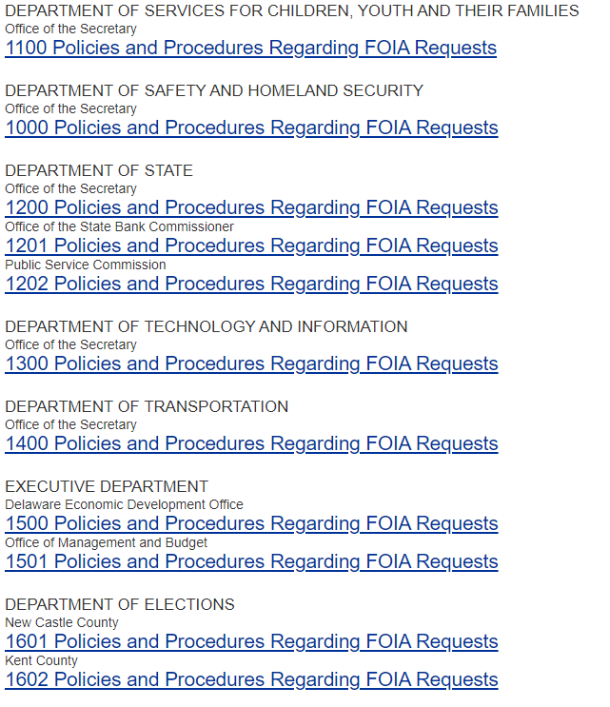
Title 8 of Delaware’s Administrative Code

Slide 32

What is a Public Record?
“Public Record” is defined in FOIA (See 29 Del. C. § 10002(o)) and the definition is purposefully very broad:
“information of any kind, owned, made, used, retained, received, produced, composed, drafted or otherwise compiled or collected, by any public body, relating in any way to public business, or in any way of public interest, or in any way related to public purposes, regardless of the physical form or characteristic by which such information is stored, recorded or reproduced.”

Slide 33
What is not a Public Record?
There are many records that are deemed not to be public records, and those exceptions are found in 29 Del. C. § 10002(o)(1)-(19).
X

Slide 34

It should be noted that FOIA requires Public Bodies to provide access to Public Records.
FOIA require Public Bodies to answer questions or create documents.
does not

Slide 35

THE Important FOIA Deadline
FOIA requires that a response to a FOIA request be made as soon as possible, but no later than 15 business days after receipt of the request. The 15 business days excludes weekends, as well as holidays and other days that State offices are closed. 29 Del. C. § 10003(h)
When does the 15-business day response period begin?
It begins when the request is received by the public body (when the designated FOIA coordinator receives the request).
35

Slide 36

What constitutes a Response to a FOIA Request?
The public body must respond with, at a minimum, one of the following:
1. That the public body is granting access the to the records requested and will provide the records;
2. That access to the records is being denied (in whole or in part) and include the basis for the denial; or
3. That additional time is needed. If additional time is needed, the response must include a good faith estimate of how much additional time is required to fulfil the request.

Slide 37

What if my Public Body missed the deadline?
If a public body misses the deadline, it is best to provide a response as soon as possible (even if a petition has been filed with the AG’s office).
PAST DUE

Slide 38

Obligation to Search Files
What is a Public Body’s Obligation to Search its Files to Identify Public Records in Response to a FOIA Request?
It comes down to answering this question: Is it clear from the face of the request that the demanded records are not subject to FOIA?
Unless it is clear on the face of the request that the demanded records are not subject to FOIA, the public body must conduct a search for responsive records.
Notes:
Waiver is of admin fees only

Slide 39

What if Additional Time is Needed?
If additional time is needed to compile the records, a response must be sent that indicates additional time is needed and must indicate one of the following statutory bases for an extension:
1. The records sought are voluminous;
2. The request requires legal advice in connection with the request; or
3. Records are in storage or archived.
Additionally, the response must include a good faith estimate of how much additional time is needed to fulfill the request. A response of “ASAP” or “soon” will not likely withstand scrutiny.

Slide 40

Requests for Emails
FOIA requires each public body attempt to fulfill requests from its own records using reasonable efforts of its own staff.
Only after an internal search with reasonable effort should a public body seek assistance from a third-party technology service provider.
Before requesting Delaware’s Division of Technology and Information (DTI) to provide e-mail records, the public body is required to provide an itemized written cost estimate to the requesting party.
DTI charges an hourly rate to retrieve emails.
Upon receipt of the estimate, the requesting party may decide whether to proceed with, cancel, or modify the request.

Slide 41

Suggested Steps to Provide Responsive Emails
Identify employee(s) most likely to have access to the emails identified in the request.
Request that the employee(s) search for responsive documents.
If an employee cannot be identified or cannot conduct the search, work with internal IT personnel to fulfill the request.
If the public body cannot fulfill the request from internal records, contact a third-party service provider to assist with the search.

Slide 42

Requests for Noncustodial Records
If a FOIA request seeks records controlled by the public body that are not within its possession or cannot otherwise be fulfilled by the public body with reasonable effort from the records it possesses, then the public body shall request that the relevant custodian provide the noncustodial records to the public body.
Before requesting any noncustodial records, the public body is required to provide an itemized written cost estimate to the requesting party, listing all charges expected to be incurred in retrieving such records.
Upon receipt of the estimate, the requesting party may decide whether to proceed with, cancel, or modify the request.

Slide 43

If a FOIA request is denied, in whole, or in part, the public body must include a reason for the denial in its response.
However, the public body is not required to provide an index or any other compilation listing each record or part of a record that was denied.
As an example, a public body does not have to produce a privilege log to support a denial of documents under either the attorney-client privilege or attorney work product privilege.
See 29 Del. C. § 10003(h)(2)

Slide 44
Fees
Presented by:
Deputy Attorney General
Joseph C. Handlon

Slide 45
Permitted Fees
The statute expressly permits a public body to charge fees
There are limits to what may be charged
Fees should be minimized to greatest extent possible
FOIA is default where Code and local law is silent - bodies may adopt an alternative fee schedule in the Code/local codes
29 Del. C. § 10003(m)

Slide 46
Administrative Fees
Statute suggests administrative fees are required, but allows public bodies to adopt policies waiving fees
Happy hour! Free
Must minimize! Charge only fees reasonably required to process request

Slide 47
Photocopy Fees
Standard copies
20 free pages
$.10 per page ($.20 double-sided)
Oversized copies (greater than 11” x 17”)
18” x 22” - $2.00 per sheet
24” x 36” - $3.00 per sheet
Larger than 24” x 36” - $1.00 per square foot
Color Copies
Additional charge of $1.00 per sheet for standard copies
Additional charge of $1.50 per sheet for larger copies

Slide 48
So What's Permitted?
Time spent processing request:
Identifying records
Monitoring file reviews
Generating computer records (whether electronic or paper)
Bill by quarter hour
Hourly rate of lowest-paid employee capable of performing the service
Notes:
It does not matter who actually does the work; if someone lower-paid is capable of doing it, that is the rate that applies.

Slide 49
Legal Review and Waivers
Can't Charge for "legal review"
Not limited to lawyers
Looking for exceptions
Subject matter review not legal
Waivers must comply with FOIA policy and be applied consistently
Notes:
Dworiak- limited exception

Slide 50
Other Charges
Microfilm/microfiche
First 20 pages free
After 20 pages, $0.15 per page
Electronic records
Material costs (e.g., CDs, Thumbs, DVDs, 8-Tracks) as well as administrative fees
Third-party custodian fees
Notes:
Discussion of DTI search

Slide 51
Estimates
“Itemized written cost estimate” for administrative fees
Provide estimate
List all charges expected
Requestor may proceed, narrow, or cancel
Estimate must be prepared in good faith
Can't discourage request
Can't create collection actions

Slide 52
Advance Payments
May require payment of some or all of the estimated costs prior to providing records
If estimate exceeds actual cost, required to refund the difference

Slide 53
Fees - Summary
Not for first 20 pages and Happy Hour
Ensure fee collection practices comply with the statute and any internal FOIA policy
Ensure that fees that are assessed are reasonable under FOIA
Estimates in advance – can request pre-payment

Slide 54
Recent Decisions on Fees
23-IB03 1/24/23 (to Amy Roe and DOE)
2 step process ok
Can charge for redactions – but not legal review
If management used, must explain why
22-IB45 11/28/22 (to Richard L. Abbott and DelDOT)
5 hour ($200) cost estimate for tab sheets that include project names, numbers, parcels areas acquired and names and addresses of owners
Records not in central location
Affidavit explaining who had to do review and why

Slide 55
Open Meetings
Presented by:
Deputy Attorneys General
Jason Staib & Emily V. Burton

Slide 56
Overview of Open Meetings
All meetings of a public body must be open to the public unless specifically exempted in the FOIA statute. 29 Del. C. § 10004(b) – (d) & (h).
Meeting: a formal or informal gathering of a quorum of the members of any public body for the purpose of gathering information, discussing, or taking action on public business.

Slide 57
Meeting Notice & Agenda
Required to provide notice of all meetings. 29 Del. C. § 10004(e) & (f).
Public notice is required for regular meetings and intent to hold an executive session at least 7 days in advance of the meeting. 29 Del. C. § 10004(e)(2).
If agenda is not available at time of initial posting of public notice, it must be added to the notice at least 6 hours in advance of the meeting and give reason for the delay in posting.
Exceptions for emergency meetings necessary for the immediate preservation of the public peace, health, or safety, and the General Assembly. 29 Del. C. § 10004(e)(1).

Slide 58
Meeting Notice & Agenda
Time, date and place of meeting and whether the meeting will be conducted under Section 10006A.
-29 Del. C. § 10004(e)(2)
Preliminary Agenda
Must include Executive Sessions if they are to be held.
Must include a period for public comment.
Do not include a “catch-all category” which is not permissible. See Chemical Indus. Council of Del., Inc. v. State Coastal Zone Indus. Control Bd., 1994 WL 274295, at *10-11 (Del. Ch. May 19, 1994).
-29 Del. C. §§ 10004(e)(2)&(e)(5)

Slide 59
Meeting Notice & Agenda
Notices/Agendas may be amended in certain circumstances
If a meeting is noticed without an agenda, an agenda may be added to the notice up to 6 hours prior to the meeting.
Must include reasons for the delay.
An agenda may be amended up to 6 hours prior to the meeting if a new matter arises requiring immediate attention.
Must include reasons for the delay.
The agenda may be changed during a public meeting to include a new agenda item if it is reasonably related to items that were noticed in the agenda.
When in doubt, schedule a new issue that arises for a future meeting with 7 days’ notice.

Slide 60
Minutes
Every meeting, including executive sessions
Record the members present, each vote taken and each action agreed upon
Unless vote is unanimous, minutes must state how each member voted and note abstentions and recusals.
Executive session minutes may be withheld from public disclosure only so long as public disclosure would defeat the lawful purpose for the executive session, but no longer.
- 29 Del. C. § 10004(f)

Slide 61
Public Comment
Presented by:
Deputy Attorney General
Victoria E. Groff

Slide 62
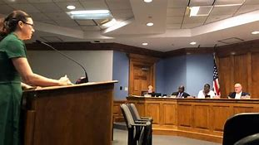
Public Comment Sessions

Slide 63
2022 Amendment
Meetings open to the public must provide an opportunity for public comment (except GA).
Time must provide "meaningful opportunity for public to engage with the public body."
May impose "reasonable time, place and manner restrictions on the length of the public comment period and amount of time allotted for each comment."

Slide 64
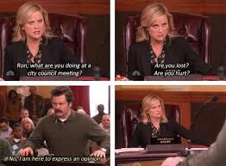
Public Comments
Required to put public comment on agenda. Del. Op. Att'y Gen. 24-IB26
Noting that member of the public and the public body will not be allowed rebuttal to the comments was found to not violate FOIA. Del. Op. Att'y Gen. 23-IB33
Restricting an individual from speaking during public comment based on his status as an intern at the public body was a FOIA violation. Del. Op. Att’y Gen. 25-IB26.

Slide 65
Executive Sessions
Presented by:
Deputy Attorney General
Victoria E. Groff

Slide 66
Calling an Executive Session
Convene an open meeting
Motion stating the reason for executive session
Limit discussion to the FOIA acceptable reason
No voting in executive session: Even if the body may enter executive session, all votes must be conducted during open session. See Del. Op. Att’y Gen. 05-IB12 and Del. Op. Att’y Gen. 18-IB37.

Slide 67
Reasons for Executive Session
An individual citizen’s qualifications to hold a job or pursue training (Applies generally only to Boards with statutory authority to hire their own employees. Does not apply to any Title 24 Board when discussing applications.) 29 Del. C. § 10004(b)(1)
Preliminary discussions on site acquisitions for any publicly funded capital improvement or sales/leases of real property. 29 Del. C. § 10004(b)(2)
Law enforcement agency’s efforts to collect information leading to criminal apprehension. 29 Del. C. § 10004(b)(3)
Discussions of identifiable, lawful, charitable contributors when anonymity has been requested. 29 Del. C. § 10004(b)(5)
Student disciplinary cases, unless open meeting requested. 29 Del. C. § 10004(b)(7)
Employee disciplinary cases or dismissal cases, unless the individual requests that it be open. 29 Del. C. § 10004(b)(8)
Personnel matters, when the names, competency and abilities of individual employees or students will be discussed unless open meeting requested. 29 Del. C. § 10004(b)(9); see also Del. Op. Att’y Gen. 18-IB42 (determining executive session related to Town Solicitor was proper purpose).

Slide 68
Reasons for Executive Session
Strategy sessions, including seeking legal advice, but only if open discussion would have an adverse effect on the public body’s collective bargaining or litigation position.
Proper Executive Session Discussions
Collective Bargaining Discussions
Pending Litigation
Potential Litigation
29 Del. C. §10004(b)(4)
See also Chemical Indus. Council of Del., Inc. v. State Coastal Zone Indus. Control Bd., 1994 WL 274295, at *10-11 (Del. Ch. May 19, 1994) for a discussion of the scope of this provision.

Slide 69

Caution!
Allowance for executive session under 10004(b)(4) require some objective signs of litigation. Examples are:
written demand letter in which a claim is asserted
prior litigation
proof of ongoing litigation with similar claims
retention of legal counsel with respect to the claim at issue and expression of intent to sue. Del. Op. Att’y Gen. 24-IB51

Slide 70
Reasons for Executive Session
Discussion of Non-Public Documents. 29 Del. C. § 10004(b)(6). See Del. Op. Att’y Gen. 18-IB05 (finding that the public body properly convened an executive session for the purpose of discussing a non-public record, or more specifically personnel records which would constitute an invasion of personal privacy, as exempted from disclosure by 29 Del. C. §10002(o)(1)).
Note: Update to Procurement Code 29 Del. C. § 6981(d)(3) and (k)(4). Proposal, proposal summaries nor proposal evaluations are open records until after receipt of signed contract. Thus, discussion of those should be in executive session under 29 Del. C. § 10004(b)(6) until the contract is awarded.

Slide 71
Executive Session – Attendees
“[S]everal of the exceptions for executive session imply the presence of non-board members (such as attorneys to discuss litigation strategy, or teachers and school administrators in student discipline cases). We believe that FOIA allows a public body to invite individuals to attend an executive session to provide information related to the subject matter for which the executive session is authorized. But a public body cannot invite non-members as observers....” Del. Op. Att’y Gen. 02-IB17.
As a matter of good policy, if a member recuses themself from the matter, they should leave the executive session. See Del. Op. Att’y Gen. 18-IB38.

Slide 72
Virtual Meetings Presented by: Deputy Attorney General Victoria E. Groff

Slide 73
Virtual Meetings
How does a Virtual Meeting occur?
Mandatory
- A public body shall allow a board member with a disability to attend a meeting through electronic means rather than in person as a reasonable accommodation.
Discretionary
- At the discretion of the chair or presiding officer, a public body may call a virtual meeting.

Slide 74
Virtual Meetings Rules
Meeting notice must include how the public can monitor or participate in the meeting.
Meeting must have an Anchor location.
Defined in 10002(b) as "physical location within the geographic jurisdiction of the public body that is open to the public and at which 1 or more members of a public body attend a virtual meeting."
Member and witness identities must be “verified” and their actions “authenticated” to the satisfaction of the Chair.
Members and witnesses must be able to do one of these:
Hear the comments of each member or witness.
Hear the comments of and view each member or witness.

Slide 75
Virtual Meeting Rules
A document “accepted by the presiding officer or chair” must be provided to every member during the meeting and “made available to the public under Section 10003 of this title.”
The public must be able to monitor the meeting through electronic means (except executive session).
23-IB08: Audio access only is sufficient.
Public must be able to provide public comment.
Minutes of the virtual meeting are still required.

Slide 76
Virtual Meetings During a State of Emergency
The COVID-19 Public Health Emergency ended May 11, 2023, but the exceptions were codified for use in a future emergency.
Any public body can hold a virtual meeting during a state of emergency.
All board members can participate by electronic means.
No anchor location required
Same public notice requirements as in-person except posting at the principal office or where the meetings are regularly held is not required

Slide 77
Virtual Meetings During a State of Emergency
If the law requires a public body to keep a verbatim transcript, the public body still must keep a verbatim transcript.
Only elected public bodies: A document used during the meeting by a member or witness that is accepted by the Chair must be immediately transmitted to each member or witness participating and the public must be able to view a recording of the meeting “within a reasonable time after” the meeting concludes.

Slide 78
Final Words on Virtual Meetings
All actions taken during a virtual meeting have the same legal effect as if it was an in-person meeting.
Virtual participants count toward quorum.
Virtual participants are allowed to vote.
Technological problems that limit public access will not invalidate the meeting or actions taken during the meeting.
Individual public bodies may have statutory authority to always have virtual meetings

Slide 79

Question and Answer

